Slide 1

Java Message service Active MQ Spring Integration
August 17, 2016
Ramon Rodriguez, Anshul Shah

Slide 2
Topics
Messages & Messaging
Messaging Uses
Java Message Service (JMS)
Message Oriented Middleware (ActiveMQ)
JMS Elements
Types of Messaging Models
JMS API programming model
Spring Integration
Lab – code examples

Slide 3
Messages & Messaging
Message is an entity of communication (bytes of data)
Communication between software components or applications
Messaging is an essential tool for building enterprise applications and ecommerce systems
It is a form of loosely coupled communication
Usually between systems rather than between humans (eg: email)

Slide 4




Messaging Uses
Ecommerce Systems
Financial Data Systems
Order Management Systems
Customer Service Communication
Social Networks
Satellite Navigation
Mobile based messaging
TV remote
Web Retailers
Financial Markets
Notifications
Social Media Networks

Slide 5
Java Message Service
Java API for sending messages between two or more clients
Part of the Java Enterprise Edition
A specification that enables:
Loosely coupled communication – it doesn’t care who is the sender and the receiver
Asynchronous messaging – to receive the message, the client is not required to send a request. It doesn’t matter whether the sender and the receiver are present/running at the same time.
Reliable Delivery – a message is guaranteed to be delivered once and only once. The message won’t get lost.

Slide 6
When Can You Use the JMS API?
You want ease of replacing components – don’t want one component to depend on information about other component’s interfaces
Don’t need all components to be online at the same time – the application can run regardless of whether all components are up and running simultaneously
Component doesn’t need an immediate response to continue running – a component can send information to another component and can continue to operate without receiving an immediate response back
Advantages?
Ability to integrate different platforms
Reduce system bottlenecks
Increase scalability
Increase reliability of message delivery

Slide 7
Basic JMS API Elements
Administered Objects – preconfigured JMS objects created by an administrator for the use of the clients
Destinations and Connection Factories
JMS Provider – The messaging system (MOM) that implements JMS interfaces
A message broker or agent (like post office / mailman)
JMS Clients – Java applications that produce or consume messages
JMS Producer/Publisher – A JMS client that creates and sends messages
JMS Consumer/Subscriber – A JMS client that receives messages
Messages – The objects that communicate information between JMS clients
Queues – staging area that contains sent messages that are waiting to be read
Topics – distribution mechanism for publishing messages in a ‘newsletter’ fashion

Slide 8
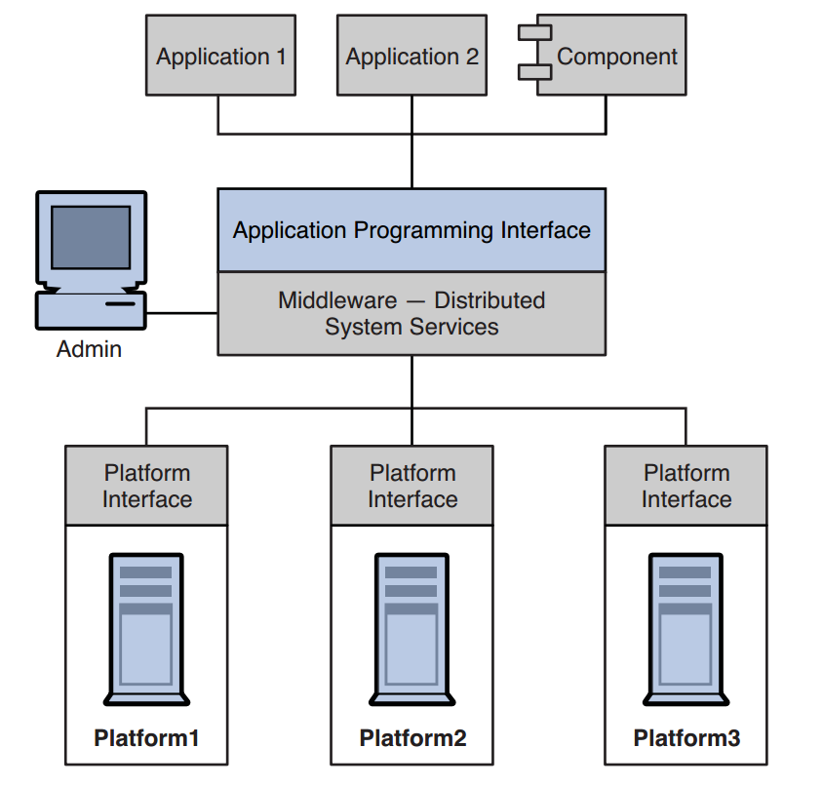
Message Oriented Middleware (MOM)
Middleware allows software components that have been developed independently and that run on different networked platforms to interact with one another
Message Oriented Middleware (MOM) is the software (or hardware) infrastructure that supports sending and receiving messages between distributed systems
A message broker (such as Apache ActiveMQ) is a type (quite popular) kind of Message Oriented Middleware

Slide 9





JMS Application
Network
Network
Sender
ActiveMQ
Receiver

Slide 10
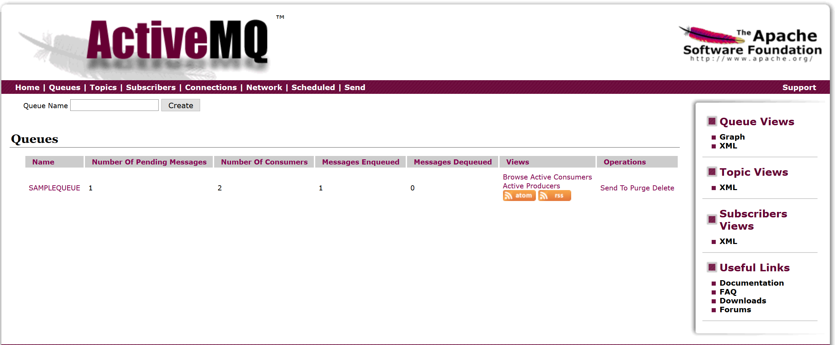
ActiveMQ
Pending Messages
# of Consumers
Messages Dequeued
Messages Enqueued

Slide 11
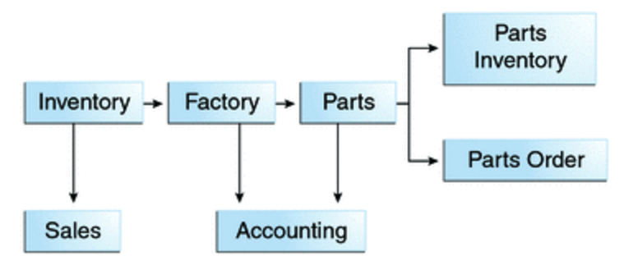
Example – An Enterprise Application
Different components of an enterprise messaging application for an automobile manufacturer:

Slide 12
Messaging Models
Messaging
PTP
Pub/Sub
“Like a newsletter/
bulletin board”
“Like a Queue”
Durable
Non-Durable

Slide 13
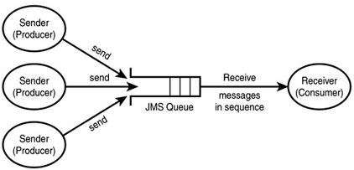
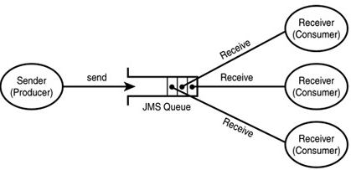

Point-to-Point (PTP)
Using this pattern, a client sends a message to a queue destination
Each message has only one consumer
A sender and a receiver of a message have no timing dependencies
The receiver acknowledges the successful processing of a message

Slide 14
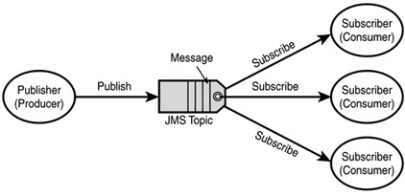
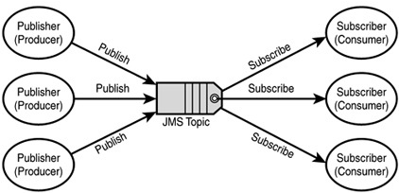
Publish/Subscribe
Publisher sends a message to a topic destination
Each message can have multiple consumers
Publishers and subscribers have a timing dependency. A client that subscribes to a topic can consume only messages published after the client has created a subscription

Slide 15
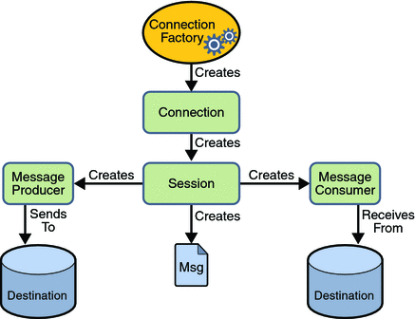
The JMS API Programming Model
Connection Factory →
Connection →
Session →
Message Producer/Consumer →
Send/Receive

Slide 16
Import the JMS API Classes
//Import the JMS API classes. import javax.jms.ConnectionFactory; import javax.jms.Connection; import javax.jms.Session; import javax.jms.MessageProducer; import javax.jms.MessageConsumer; import javax.jms.Queue; import javax.jms.Session; import javax.jms.Message; import javax.jms.TextMessage;

Slide 17
JMS Client
//create connection factory ConnectionFactory cf; //create a connection Connection connection = cf.createConnection(); //create a session within the connection Session session = connection.createSession(false, Session.AUTO_ACKNOWLEDGE); //create a destination object for Point-to-Point Destination dest1 = session.createQueue(queueName); //for Publish-Subscribe Destination dest2 = session.createTopic(topicName);

Slide 18
Producer
//setup connection and create a session
//create producer MessageProducer producer = session.createProducer(dest1); //send a message Message m = session.createTextMessage(); m.setText("This is a text message"); producer.send(m); //close the connection connection.close();

Slide 19
Consumer - Synchronous
//setup connection and create a session //create consumer
session.createConsumer(dest1); MessageConsumer consumer = session.createConsumer(dest1); //start receiving messages connection.start(); Message m = consumer.receive();

Slide 20
Consumer - Asynchronous
//setup connection and create a session //create consumer MessageConsumer consumer = session.createConsumer(dest1); //for asynchronous delivery, register a MessageListener object with the //message consumer MessageListener listener = new myListener(); consumer.setMessageListener(listener); //myListener should have onMessage() public void onMessage(Message msg){ //read the message }

Slide 21
Spring Integration Framework
Spring provides a JMS integration framework that simplifies the use of the JMS API
JMS can be divided into 2 areas of functionality
Production of messages
Consumption of messages
The JMS Template class is used for message production and synchronous message reception
For asynchronous reception, Spring provides a number of message listener containers that are used to create Message-Driven POJOs (MDPs)

Slide 22





Spring and Camel - Similarities
Open source licensing - both Spring and Camel are under the Apache License
Commercial support available for both; especially for integration frameworks, they are used in mission critical systems usually so the support is important

Slide 23
Integration for Spring and Camel - Differences
Connectivity
(AMQP, AWS, Feed, File FTP, Jetty, GemFire, HTTP, TCP, UDP, JDBC, JMS, Mail, MongoDB, Redis, RMI, SFTP, SQL, Stream, Twitter, Web Service, XML, XMPP…)
Spring has the most important ones available, easy to create own connectors using template
But less connectors than Camel, also less for business applications like Salesforce, SAP, etc.
Domain Specific Language
Spring integration uses XML
Camel has more choices - uses XML, Java, Groovy, Scala
Community
Mailing lists, forums, blogs, articles, conference talks – Camel seems to have a larger community for integration (Spring has a larger community for Spring itself not for integration)

Slide 24
Additional Resources
Bitbucket repository
https://bitbucket.org/RAM0N_LUIS/jms-activemq-spring
ActiveMQ Configuration: http://activemq.apache.org/initial-configuration.html
Java JMS tutorial: http://www.oracle.com/technetwork/java/jms/index.html
ActiveMQ Official HelloWorld Program: http://activemq.apache.org/version-5-hello-world.html
Spring Official ActiveMQ Example: https://spring.io/guides/gs/messaging-jms/
Spring ActiveMQ Walkthrough with Example Code: http://xpadro.blogspot.com/2015/04/configure-spring-jms-application-with.html
JMS & Spring References: http://docs.spring.io/spring/docs/current/spring-framework-reference/html/jms.html

